Slide 1
Global Housing Panorama and COVID-19 Measures:
An Analysis of 50 Countries
Prepared by :
Andre Farmer
Asantie Murrell
Lydia Caldana
Nora Thajudeen
Radhika Joshi
Supervised by :
Zeynep Turan
July 20, 2020

Slide 2
The International Right to Adequate Housing and COVID-19
Millions of people around the world live in precarious environments that do not provide dignified living conditions, including those in overcrowded slums and informal settlements, and those who are forcefully evicted (or threatened with forced eviction). The COVID-19 has exacerbated the already existing issues in housing. The international human right to adequate housing is recognized by the 1948 Universal Declaration of Human Rights and in the 1966 International Covenant on Economic, Social and Cultural Rights, among other international human rights treaties.
UN-Habitat provided us with existing datasets and we have conducted extensive research to update it as well as find COVID-19 specific measures. The deliverables include this presentation and a written position paper, which will inform UN-Habitat's 2020 Global Housing Report.
Given the critical context this fundamental human right is facing, this report analyzes government's actions through: a) existing housing policies as guidelines for dignified living; b) sustainable building codes and how housing is contributing to make the world more sustainable; c) forced eviction policies and how governments are guaranteeing this human right.
HOUSING POLICY: Definition
Housing policy or a national housing is a government's plan that: defines the objectives for the development of the housing sector; identifies the resources available to meet these goals; specifies the most cost-effective way of using them; outlines the responsibilities and time frame for the implementation of the necessary measures; monitors results and ensures adequate remedies for violations. UN-Habitat, "The Right to Adequate Housing", Fact sheet no. 21

Slide 3
Agenda
Global Overview
Global analysis of housing policies
Preliminary conclusions
Emerging trends about housing and COVID-19 measures, per region
Regional Overview and Policy Recommendations
Africa
Asia & the Pacific & Russia
Latin America & the Caribbean
Middle East & North Africa
Organization for Economic Co-operation & Development
Global Conclusions and Recommendations
Global Conclusions and Recommendations

Slide 4
1. GLOBAL OVERVIEW

Slide 5
Global Panorama: Countries by Region
Africa | Asia & the Pacific & Russia | Latin America & the Caribbean | Middle East & North Africa | Organization for Economic Co-operation & Development
Angola | Afghanistan | Argentina | Egypt | Australia
Ethiopia | Cambodia | Brazil | Iraq | Bulgaria
Ghana | China | Colombia | Jordan | Canada
Kenya | India | Chile | Lebanon | France
Mozambique | Indonesia | Dominican Republic | Morocco | Germany
Nigeria | Malaysia | Ecuador | Qatar | Japan
Rwanda | Pakistan | Honduras | Saudi Arabia | Sweden
Senegal | Russian Federation | Mexico | Sudan | Turkey
South Africa | Thailand | Paraguay | Tunisia | United Kingdom
Zambia | Vietnam | Venezuela | United Arab Emirates | United States

Slide 6
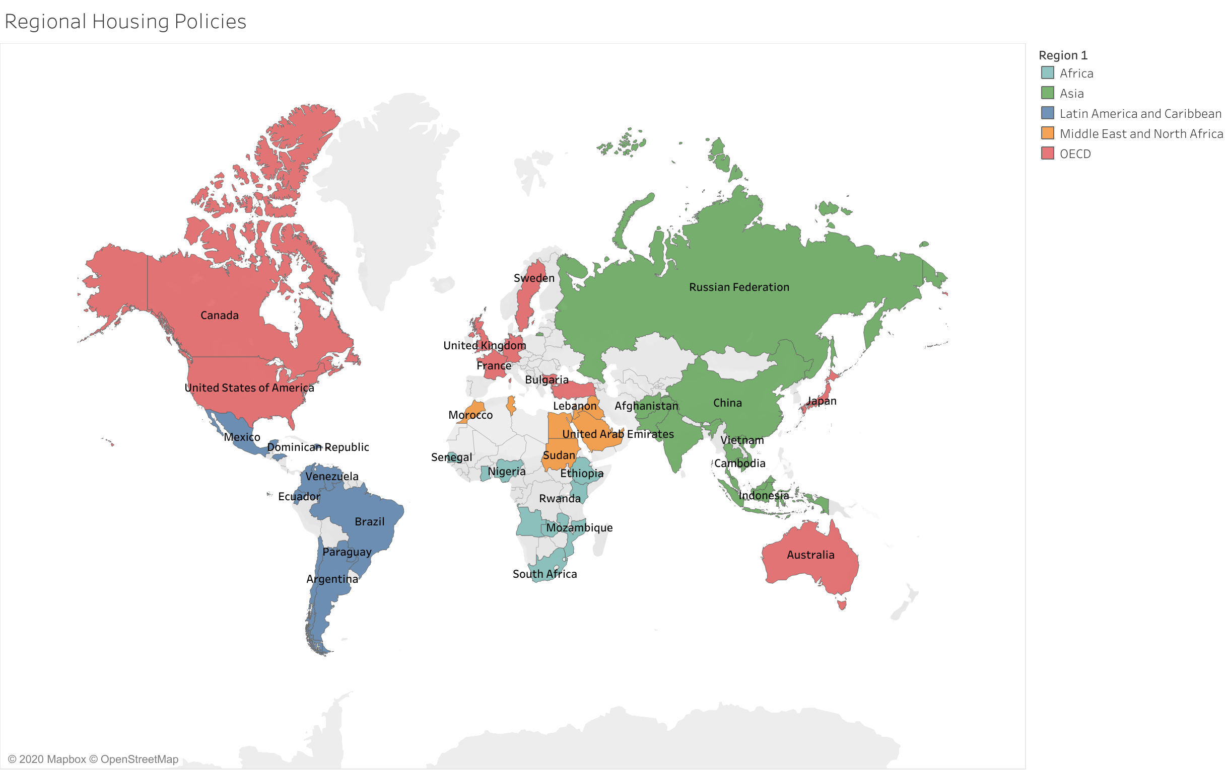
Global Panorama
This slide will contain a map highlighting the countries researched in this study.
Colombia

Slide 7
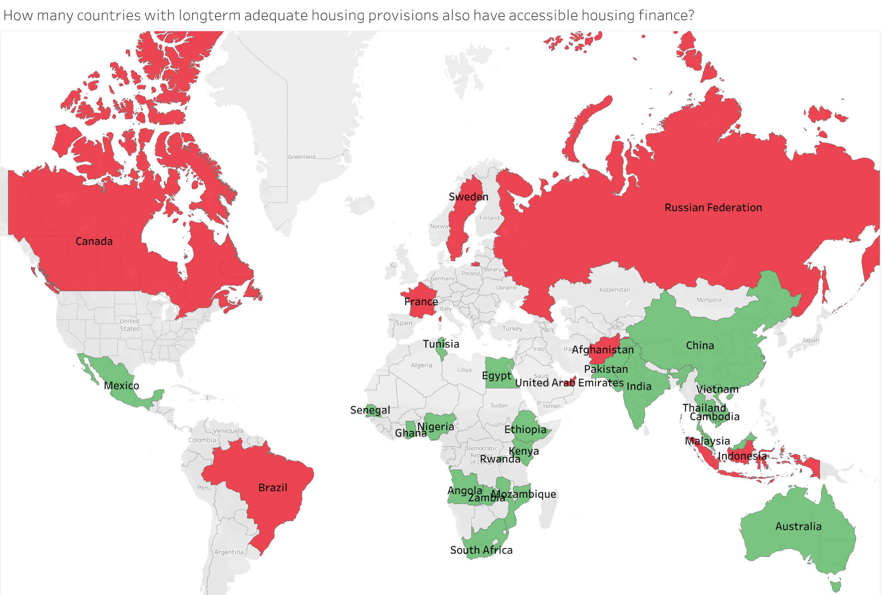
Global Overview: Mapping of Housing Policies
1.a
These slides will contain maps highlighting the countries with housing policies and strategies, eviction frameworks and sustainability codes and frameworks.

Slide 8
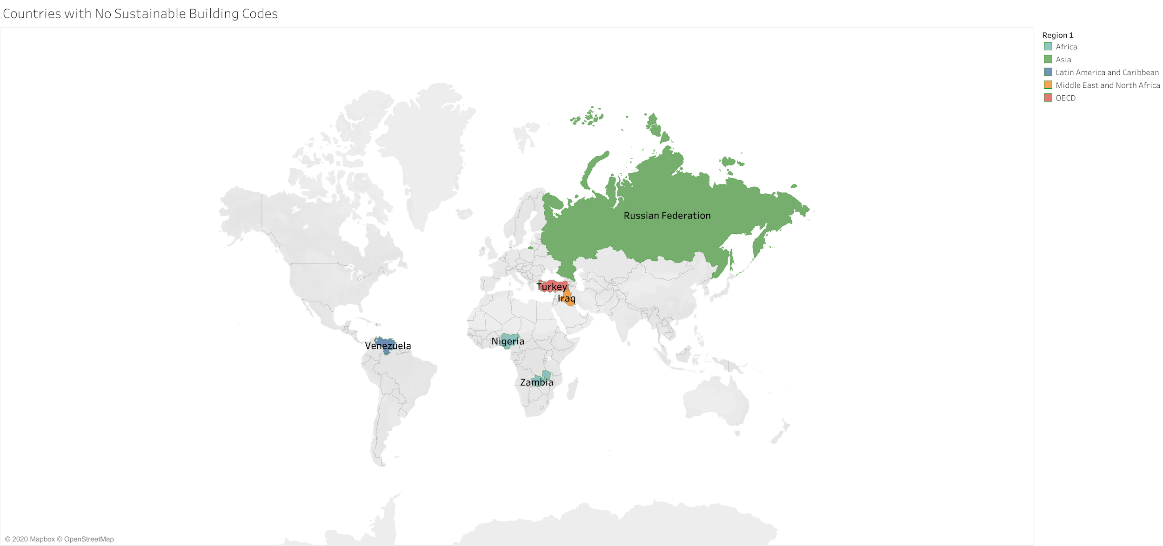
Global Overview: Mapping of Housing Policies
1.a
These slides will contain maps highlighting the countries with housing policies and strategies, eviction frameworks and sustainability codes and frameworks.
Only 6 out of the 50 analyzed countries don't possess sustainable building codes.

Slide 9
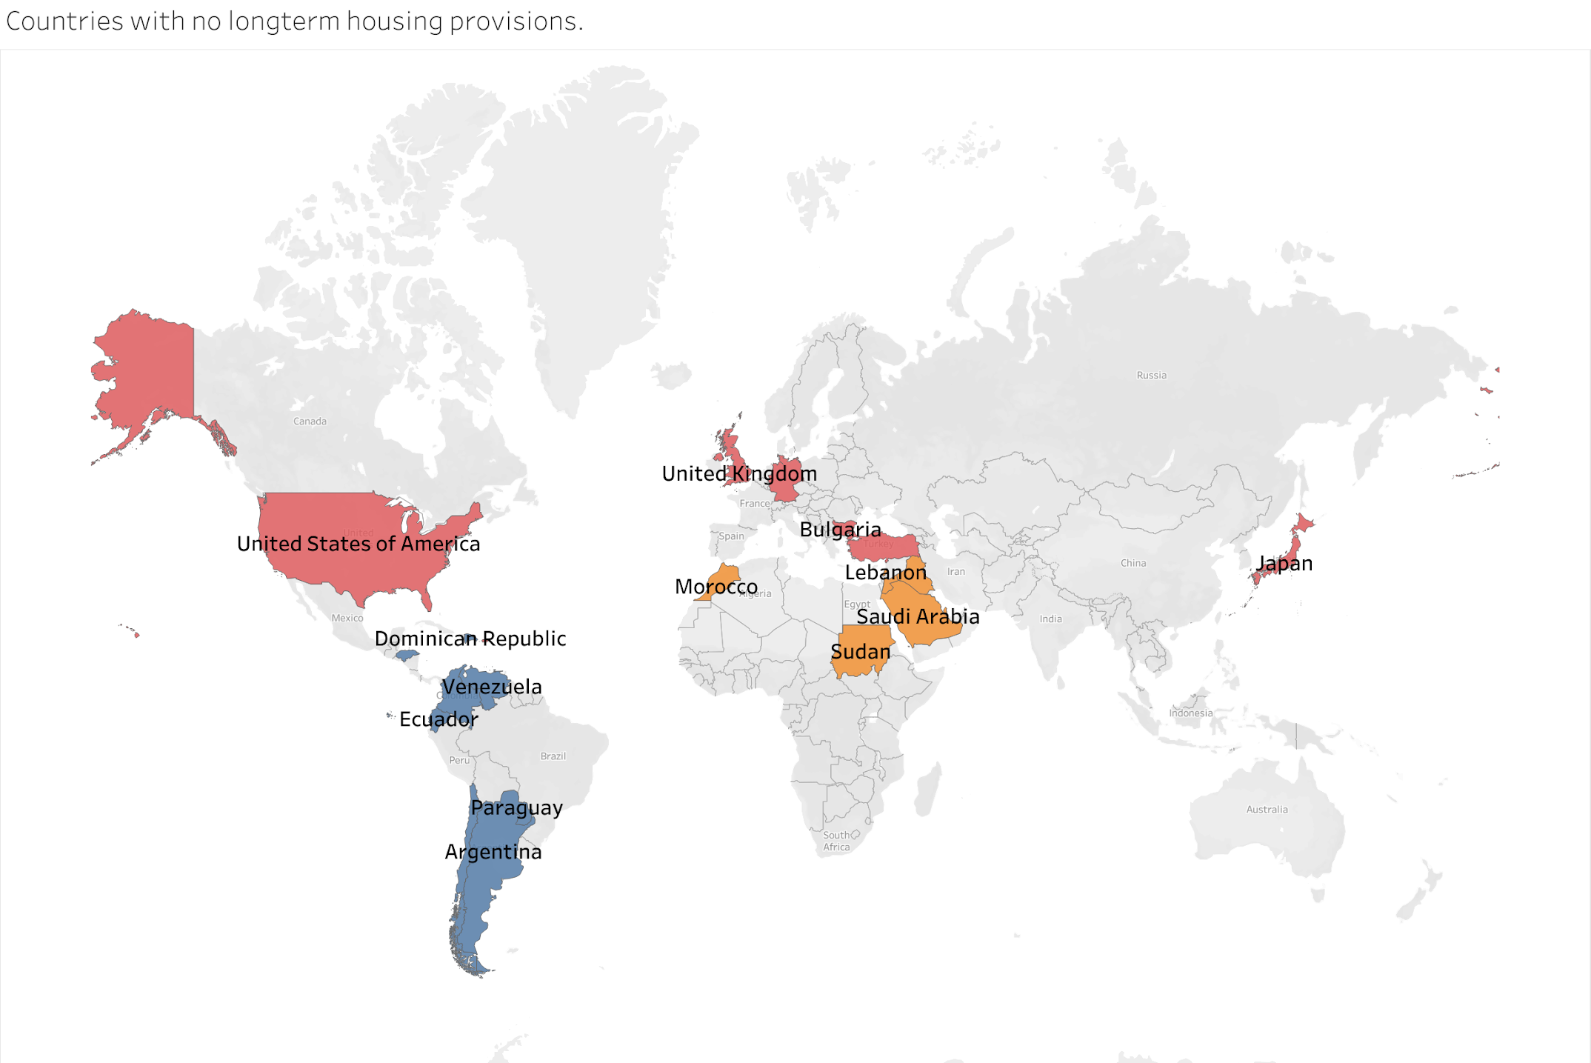
Global Overview: Mapping of Housing Policies
1.a
These slides will contain maps highlighting the countries with housing policies and strategies, eviction frameworks and sustainability codes and frameworks.

Slide 10
Global Overview: Preliminary Conclusions
1.b
Some of the conclusions of this research include:
All regions have assistance and housing programs that could be extended beyond the emergency COVID-19 measure;
Vulnerable populations' right to housing are more threatened due to COVID-19;
Many countries lack long-term adequate housing programs;
There is room for improvement in terms of eviction policies and implementation;
There are efforts towards green building and sustainable use of energy, but unequal economic contexts impact how much each region implements them.

Slide 11
2. REGIONAL OVERVIEW
AND POLICY RECOMMENDATIONS

Slide 12
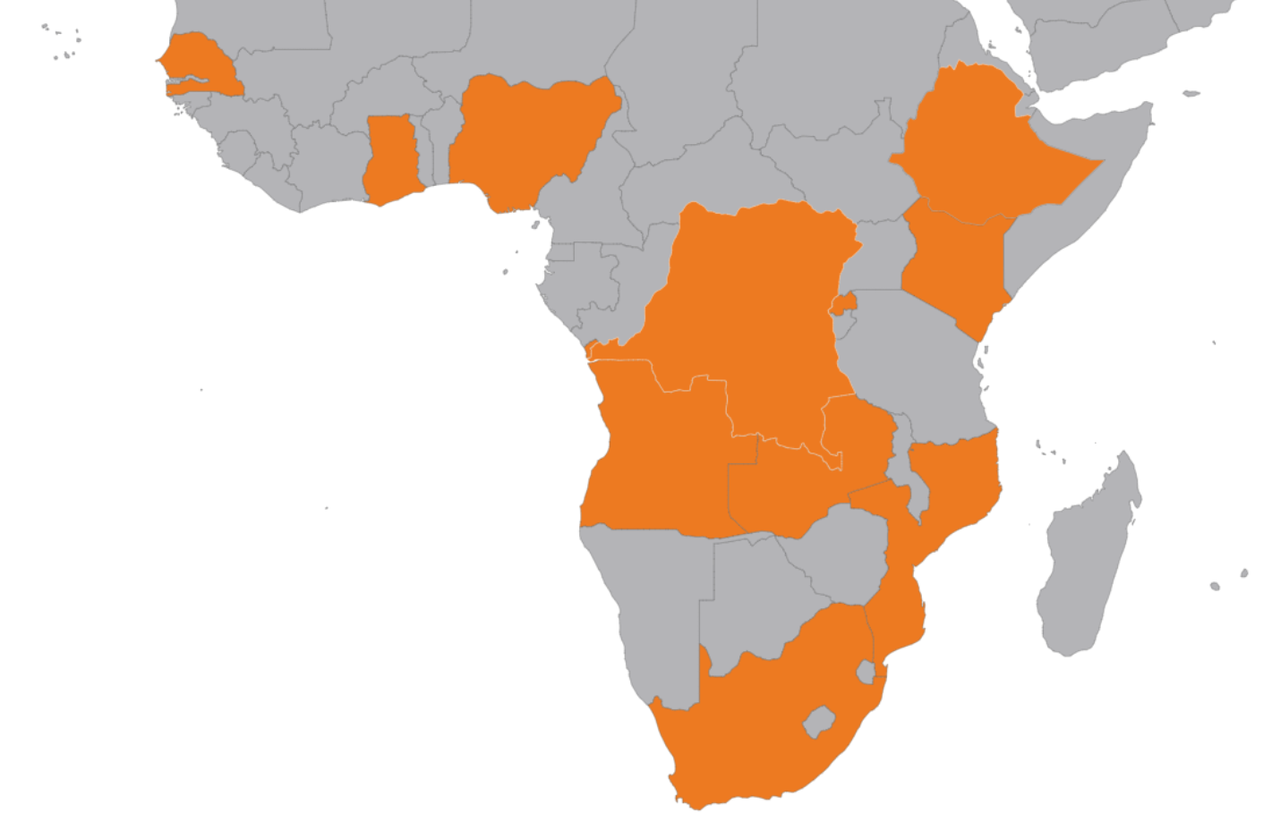
Regional Overview: Africa
Angola, Kenya, Senegal, Ghana, South Africa, Ethiopia, Mozambique, Nigeria, Rwanda, Zambia
2.a
The region’s issues fold into one another. The following boxes highlight some key issues identified:
RAPID URBANIZATION:
The African region has the fastest rate of urbanization. There is a considerable and challenging deficit of land and adequate housing exacerbated by the pandemic.
PUBLIC-PRIVATE PARTNERSHIPS:
National housing policies within the studied region depend on collaborations with private developers. The general framework for the collaboration involves land provided by the government and construction by developers.
LACK OF INFRASTRUCTURE:
The studied region has large portions of population living in informal settlements, however, slum upgrading policies are not found. The national housing policies primarily involve building new housing, which is only accessible to middle income households.
HOUSING FINANCE GAP:
While PPPs are the main focus, due to costly construction materials, new projects aren’t affordable to many. Financing options are extremely limited. Some have launched mortgage companies, others, like Senegal, have several policies like autoconstruçao and extensions of payment deadlines to reduce monthly costs.
Data Gap: Information on housing rights and options are limited. This increases the vulnerability of low-income households who may not be aware of their rights. The region’s lack of data available may further marginalize low-income tenants.

Slide 13
Africa: Housing Panorama
Angola, Kenya, Senegal, Ghana, South Africa, Ethiopia, Mozambique, Nigeria, Rwanda, Zambia
2.a
Housing Policies
The region’s overarching thematic struggle is bridging the housing finance gap.
Updates include:
New affordable housing being built:
Angola, Ethiopia, Rwanda, and Kenya.
New Affordable Mortgage Institutions aimed at bridging housing finance gap: Ghana and Kenya.
Deliberately inclusive housing policy mandates 30% of all development targeted towards low-income households: South Africa.
Sustainable Building Codes
Environmental Assessments and Sustainability: Angola (Environmental Impact Assessment), Kenya (The Energy Act, 2006), Senegal (Green Secondary Cities Program), Ghana (first Building Code (2018) has been & Land Bill of 2017 mandates a variety of sustainable land administration and management practices).
Forced Eviction Policies
Eviction Laws and Frameworks are present in the region. There is little evidence of widespread implementation.
Angola: Working with tenants of affordable housing schemes to change terms of their loans and extending payment deadlines to avoid evictions.
xEthiopia: political will exists; mass forced evictions still a problem according to Amnesty International.
Kenya, Nigeria, Senegal, Zambia all have Forced Eviction policies in their legal framework.

Slide 14
Africa: Covid-19 Measures
Angola, Kenya, Senegal, Ghana, South Africa, Ethiopia, Mozambique, Nigeria, Rwanda, Zambia
2.a
2
Freezing or deferral of mortgage/rent/ housing payments:
Ethiopia: For the duration of pandemic
x Kenya: forcefully evicted 5000 people in informal settlements despite court order to stop.
Provisions for Housing
For people in need of isolation:
Ethiopia: duration of pandemic - converted universities and conference centers into isolation centers.
Nigeria: has temporarily converted assets seized in fraud cases into isolation centers.
x Angola: will only pay for sanitation and logistics cost of isolation, not for isolation centers in private institutions like hotels.
For people with inadequate housing:
x South Africa: has locked up homeless in Cape Town in homeless camps guarded by the police, where social distancing is not possible due to crowding. Cannot leave unless they can prove they have place to go.
1
Eviction Moratoria
No Covid-specific policies, however, eviction policy exists in Angola, Ethiopia, Kenya, Nigeria, Senegal, and Zambia. Many are not implemented.
3
Note: unable to find information for Senegal, Rwanda, and Zambia

Slide 15
Conclusions and Policy Recommendations: Regional
2.a
Africa
Integrating Land Trusts and Funds Into Policy: integrating communal Land Trusts and Land Funds into National Housing Policies formalizes these institutions, offering more funding options for development of adequate and affordable housing. This additionally provides legal protections to tenants and members of these institutions. A success story is the Tanzania-Bondeni CLT in Voi, Kenya.
Public Knowledge of Housing Rights Lacking: Data on citizens’ housing rights are difficult to navigate. Readability and accessibility to information on legally guaranteed rights is important for individual citizens to be able to participate actively in their housing needs. A public service campaign is recommended to make households aware of their housing rights.
Provision of Affordable Adequate Housing: Housing provisions exist but not enough to meet the deficit in housing supply. Informal settlements provide housing at a much faster rate than the formal - this requires slum upgrading to be step one in providing adequate housing while residents wait for housing deficit to be addressed. Community-based upgrading systems need to be implemented.
Integrating Upgrading Informal Settlements Into Policy: integrating upgrading informal settlements into National Housing Policies will benefit the most vulnerable members of localities and formally recognize informal settlements as temporary housing that needs support. Recognition becomes the very first step in the direction to providing temporary housing to households while the housing deficit is being addressed.
Housing Policies Must Be Viewed as More Housing: Provision of Affordable Housing must also be seen as more than just providing houses. It needs to be viewed as a potential economic booster, the demand pre-exists the supply. Local construction materials industry need to be fostered. Locally produced construction materials could be offered at a reduced subsidized cost for those building their own homes with the aid of National Housing Policy Initiatives. Additionally, a standard architectural framework must be made available for households to adequate housing.
1
2
3
4
5

Slide 16
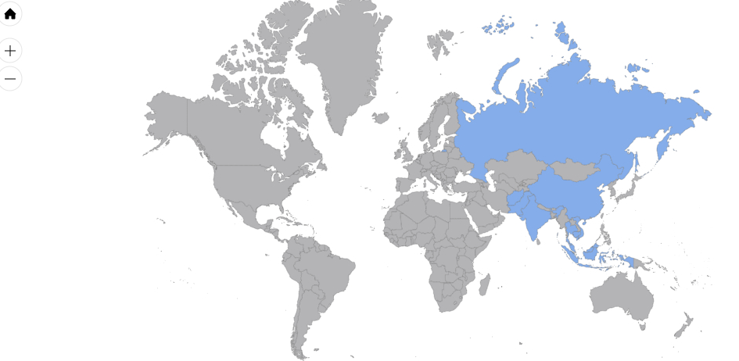
Regional Overview: Asia & the Pacific & Russia
Afghanistan, Cambodia, China, India, Indonesia, Malaysia, Pakistan, Russian Federation, Thailand, Vietnam
2.b
The following provides context for some of the region’s overarching issues:
URBANIZATION:
In the Asia & the Pacific region, people migrate to urban areas and cities for work and better opportunities but are often living in inadequate housing in informal settlements on the outskirts of these areas.
CLIMATE CHANGE:
The region is highly susceptible to harsh climate change effects which poses significant challenges specifically regarding land and housing security.
LOW-INCOME POPULATION:
Across the region there are millions of low-income workers and households which have needed assistance before and during the pandemic. This is a major issue for which private investment is being sought to provide solutions.
POLICY & LEGAL FRAMEWORKS:
Provide only for formal tenures and do not allow for adequate provisions for the rights of vulnerable populations. (Source: Global Land Tool Network, 2015)
In researching this region, updated Eviction Law and legal frameworks found were very limited thus highlighting an important gap in adequate housing policy which undoubtedly poses a threat to tenants in these countries.

Slide 17
Asia & the Pacific & Russia: Housing Panorama
Afghanistan, Cambodia, China, India, Indonesia, Malaysia, Pakistan, Russian Federation, Thailand, Vietnam
2.b
Housing Policies
All ten countries in this region have affordable and/or adequate housing as part of their National Housing Policies, Strategies or Initiatives.
Financing Opportunities for Low-income Populations: India, Malaysia, Pakistan, Thailand, Vietnam.
Private Sector Investment: Afghanistan, Cambodia, India, Pakistan.
Sustainable Building Codes
The majority of the countries in the region
have sustainable codes, frameworks or guidelines for housing and infrastructure.
Construction Law: Cambodia
Building Codes: Afghanistan, India, Thailand
Green Building Regulation: China, Indonesian, Malaysia, Vietnam
Forced Eviction Policies
Eviction Laws and Frameworks are limited in the region.
India: Various state laws protect tenants from evictions which are strictly regulated.
Malaysia: Specific Relief Act 1950 stipulates that a landlord is prohibited from evicting the tenant and/or recover possession of the demised premises without a court order.
Thailand: the law and also the culture seemingly protect against the eviction.

Slide 18
Asia & the Pacific & Russia: COVID-19 Measures
Afghanistan, Cambodia, China, India, Indonesia, Malaysia, Pakistan, Russian Federation, Thailand, Vietnam
2.b
1
2
Freezing, discounting or deferral of mortgage/rent/ housing payments:
Freezing or Suspension of Payments: Malaysia
Discounted Rent/ Housing Payments: Cambodia, Indonesia, Vietnam
Deferral of Payments: Afghanistan, Cambodia, China, Russian Federation
3
Provisions for Housing
For the vulnerable, homeless, migrant workers, medical staff: India, Indonesia, Malaysia, Vietnam
For people with inadequate housing: India, Indonesia, Malaysia and Vietnam have provided short term housing/shelters for those with inadequate housing
For people in need of isolation: Cambodia, China, India and Vietnam have prepared shelter or temporary housing for those who were potentially affected by COVID-19.
Eviction Moratoria:
There was a limited response to the threat of eviction for tenants:
India: In Delhi there is a government regulation (GR) declared there will not be forceful evictions by the homeowners / landlords of those families who are living on rent / lease.
Pakistan: In Punjab, an order stipulated that landlords were no to evict tenants forcefully, illegally or without due process of law, on account of non-payment/delay of payment of rent.

Slide 19
Conclusions and Policy Recommendations: Regional
2.b
Asia & the Pacific & Russia
Forced Eviction Policy/ Eviction Law: Laws and provisions regarding eviction appear to be lacking in the region which poses a serious problem for tenants during a pandemic such as COVID-19. These policies should be present in legislation to safeguard persons from being evicted from their homes, especially during health crises.
Levels of governance: More cooperative approaches are needed to coordinate different levels of governance to ensure that some who are in need are not excluded from assistance.
Housing Emergency Measures: Integrate housing measures, beyond lockdown procedures, into emergency decrees and/ or disaster plans which are used to address health crises like COVID-19, particularly designated housing facilities for the vulnerable. Possibly, these housing measures can be devised with wider National Housing Policies or Strategies.
Provision of Affordable Housing: Ensure demand and supply side mechanisms for the provision of housing by private entities are formulated in tandem with national and state housing targets.
Housing for the Vulnerable: Include considerations and make provisions for the homeless and migrant workers in the formulation of National Housing Policy. Great focus has been placed on low-income persons and families, however, the pandemic shows the precarity of solutions for the homeless and migrant labour.
1
2
3
4
5

Slide 20
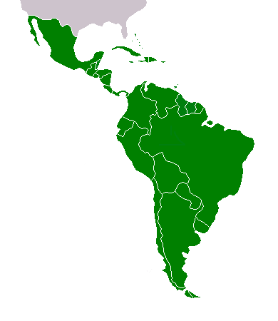
Regional Overview: Latin American and the Caribbean
2.c
Argentina, Brazil, Colombia, Chile, Dominican Republic, Ecuador, Honduras, Mexico, Paraguay, Venezuela
DOMESTIC VIOLENCE
AND SAFE HOUSING:
The implementation of social distancing has increased victim's time spent with their aggressors inside their homes, with very little policies and measures to shelter and care for women in inhospitable homes.
LACK OF SAFE SANITATION:
In 2018, 490 million people in the region did not have access to safe sanitation.
Mx
DR
Hn
Vz
HIGHLY UNEQUAL LAND DISTRIBUTION:
The region ranks last in land distribution, with a Gini coefficient of 0.79. One percent of farms occupy more than half of productive land. In other words, that one percent holds more land than the remaining 99 percent.
Co
Ec
INFORMAL SETTLEMENTS:
24.4% of the region’s population live in precarious urban settlements.
Br
Ch
Pr
Ar
IN NUMBERS:
7 countries have updated their housing policies - and 2 mention 'smart city'.
8 countries possess sustainable building policies and frameworks.
4 countries possess policy for tenure security.

Slide 21
Latin America and the Caribbean: Housing Panorama
2.c
Argentina, Brazil, Colombia, Chile, Dominican Republic, Ecuador, Honduras, Mexico, Paraguay, Venezuela
Housing Policies
Tools for urban development and updated housing policies: Present in 7 out of the 10 countries. Honduras, Venezuela, Mexico, Ecuador, Paraguay, Brazil, Colombia.
Smart cities:
Brazil includes the term "smart city" in its housing and territory strategy plan, related to urban-environmental and economic sustainability.
In Colombia, the Programa Medellín Ciudad Inteligente focuses on production of technology through a tech hub, and communication technology to serve the population and government through big data.
Sustainable Building Codes
All analyzed countries in the Latin American and Caribbean region present some form of sustainable housing policy, except for Venezuela.
Sustainable building and material policies and frameworks: Present in 8 out of the 10 countries. Honduras, Mexico, Colombia, Brazil, Ecuador, Paraguay, Chile, Argentina.
Sustainability Certificate: Colombia, Dominican Republic, Mexico.
Energy Efficiency: Mexico, Argentina, Honduras.
Forced Eviction Policies
Policy for tenure security: Honduras, Dominican Republic, Argentina, Colombia.
Concentration of land ownership:
Most countries present a Gini coefficient above 0.80. Most unequal countries are Colombia (despite its Gini coefficient of 0.88), Paraguay (0.93) and Chile (0.91).
Gender gap in land ownership: In Latin America, women account for less than 12% of the population that benefits from agrarian reform processes.
Indigenous peoples and land: It is estimated that 23% of Latin American lands are managed or are in the hands of indigenous peoples. COVID-19 has worsened the threats to their rights to the land.

Slide 22
Latin America and the Caribbean: COVID-19 Measures
2.c
Argentina, Brazil, Colombia, Chile, Dominican Republic, Ecuador, Honduras, Mexico, Paraguay, Venezuela
1
2
3
Eviction Moratoria
Argentina (until September 2020) Colombia (until June 2020) Paraguay (until June 2020) Venezuela (until September 2020) Outliers: Mexico: forcefully evicted 65 migration stations (3,759 people from Honduras and El Salvador) “to avoid new COVID cases”. Honduras: during COVID-19, the originary, rural and LGBTQI populations are suffering from violent evictions. Brazil: 2,000 people in the state of São Paulo were evicted during COVID-19.
Freezing or deferral of mortgage/ rent prices/ housing payments
Freezing of mortgage and rent prices: Argentina, Chile and Paraguay.
Provision for Housing
Provisions for people without adequate homes, women, medical staff and indigenous populations: Brazil, Paraguay, Chile, Ecuador and Mexico.
Chile's Residencias Temporarias (Temporary Residences): temporary house people who tested positive for COVID-19, and who cannot self-isolate at home; and Albergue Protege Calle COVID-19 serves as shelters for those who don't have homes.

Slide 23
Latin America and the Caribbean: Policy Recommendations
2.c
Argentina, Brazil, Colombia, Chile, Dominican Republic, Ecuador, Honduras, Mexico, Paraguay, Venezuela
Latin America & the Caribbean
Improve land ownership: Community-based land trusts, which finance nonprofit organisations to build and manage housing developments on behalf of a community, could facilitate land ownership for lower-income populations.
Increase tenure security: Measures that were implemented during COVID-19, including the flexibilization of rent payment and moratoria on eviction should be absorbed by the governments' laws as a permanent measure for vulnerable and lower-income populations.
Short-term housing into long-term adequate housing: The extra space that was created for medical professionals, homeless, elderly and women should become long-term housing solutions that provide the vulnerable with adequate homes.
Increase women’s access to funding or renting housing: By taxing people who earn more with higher rates and developing tax reforms, money could be invested in homes for vulnerable and lower-income women.
5
Flexibility of planning: Develop a variety of housing options that serve different kinds of families structures (intergenerational, non-binary, etc.).
More rigorous approaches to implementation and fiscalization of sustainable building codes: While the frameworks might already be there, they are not being implemented to the full scale and capability. Rewards schemes and incentives are needed in order to mainstream sustainable development.
Reform social-assistance schemes to extend beyond low-income households: To ensure that the “missing middle” will have access to housing.
Continue emergency income support for low-income households: So that workers and businesses operating in the informal economy can use steady income for land ownership.
1
6
2
3
7
8
4

Slide 24
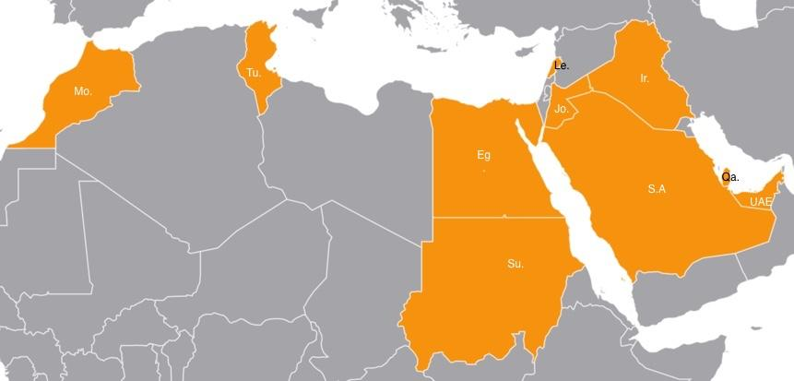
Regional Overview: Middle East & North Africa
2.d
Jordan, Egypt, Saudi Arabia, Morocco, Tunisia, UAE, Lebanon, Iraq, Sudan, Qatar
Strain on economy and weak social programs effects most vulnerable:
GOVERNMENT HOUSING MEASURES:
Austerity through IMF loan conditions/ econ policy advice. Strict preventative measures in Qatar and UAE. Egypt avails preventative measures to mitigate impact on women and children. Limited cash transfers to refugees in Jordan and Lebanon fail to meet needs of households.
INFORMAL HOUSING:
Lack of social cohesion and protection linked with informality. 90% of Saudi Arabian workers as migrants cannot access or demand labor rights. 63% in Morocco, 71% in Lebanon. Many in informality throughout the area are left out of social protection measures. 1/3 of unemployed are women. Highest youth unemployment globally 27%.
HOUSING DEVELOPMENT GAPS:
UAE leads in testing COVID, aims to diversify from energy sector, pressuring MENA states like South Sudan which remains severely underdeveloped: scarce plumbing and paved roads. Only 2% of population have electricity.
LAND EXCLUSION:
Both spatial exclusion from striking wealth gap, Military-strategic planning, have placed risks on poor populations’ right to housing.
Top 10% richest of the population owns 64% of the wealth. Financially motivated spatial exclusion causing need for affordable housing
High concentration of informal Housing
Regressive Emergency Redistributive Measures

Slide 25
Middle East and North Africa: Housing Panorama
2.d
Jordan, Egypt, Saudi Arabia, Morocco, Tunisia, UAE, Lebanon, Iraq, Sudan, Qatar
Housing Policies
Policies in MENA feature protecting women and children and creating sustainable connections to the private sector:
Morocco - 2017 House of Representatives passed a renting and leasing law. In 2018, Moroccan executive power made a map with plans to revive the housing sector, in an economic downturn.
Egypt - President Sisi has launched large affordable housing project in the capital Cairo, which include health units, nurseries and social buildings.
Tunisia - 2017, First Tunisian Housing Programme with $80M, targeting middle income households wanting to buy 1st home.
Forced Evictions
Forced evictions are major threat to individuals who are informally settled. Civilians track regional voluntary guidelines around tenure:
Sudan - evictions represent a constant risk for many communities internally displaced people (IDPs) living in abandoned or unused buildings
Lebanon - In April 2020, lack of secure tenure leads to forced evictions. They are justified by security concerns and remain a serious issue for Syrian refugees.
Iraq - Risk of evictions for IDPs, due to loss of employment, and insecure tenure.
Sustainable Building Codes
Green building codes in MENA have largely imitated western criteria and guidelines more specific to region is needed:
Sudan: Sudan inaugurated its first Sustainable Building Council in April of 2018.
Qatar: In 2018, the Ministry of Municipality and Environment (MME) released the sixth edition of Qatar Construction Specifications (QCS).
Saudi Arabia: In 2017, The Saudi Green Building Forum (SGBF) became the newest member of USGBC’s LEED International Roundtable, after building 1st LEED Platinum single family home.

Slide 26
Middle East and North Africa: COVID-19 Measures
2.d
Jordan, Egypt, Saudi Arabia, Morocco, Tunisia, UAE, Lebanon, Iraq, Sudan, Qatar
COVID-19 worsens already weak economies. Measures do not match scale of housing needs.
1
2
3
Responsive Measures
Only 11% of MENA Stimulus packages targeted people through social protection and health measures
Egypt social assistance insurance intervention 4.7b compared to financial intervention 11b. March 2020, Moroccan government has launched a set of initiatives to provide shelters for the homeless as response to pandemic.
Jordan and Tunisia $0.08b in social assistance and insurance support compared to $1.4b for financial recovery.
Jordan coordinates COVID-19 support measures, only for Jordanians, not Syrian or other refugees- leaving refugee support to UN, who hasn’t responded and other orgs with less resources.
March 2020, over 150 Tunisians, mostly women, housed in isolated factory for one month to take up production of protective gear for the country.
Eviction Moratorium
Abu Dhabi and Dubai of UAE have issued the only moratorium on evictions in the MENA region. Declining GDPs compound austerity from G20 as they crack down on the debt externalized onto the lowest income populations in the region.
Privatization of housing in Lebanon central business district has left 300,000 people homeless from Beirut’s 2020 explosion.
Housing Policies
In June, 2020, President Sisi of Egypt expanded housing scheme to replace informal settlements with new homes for slum residents.
Saudi Arabia repatriation program provides temporary housing for expatriates in April, 2020.
Resident permits for Tunisian workers were extended in March 2020
Jordan imposes a minimum lot size of 100 square meters, restricting the supply of affordable formal housing.

Slide 27
Conclusions and Policy Recommendations: Regional
2.d
Middle East and North Africa
Employment for Women and Youth: Housing measures should include youth job-training programs to capitalize on the untapped human capacity of the 27% unemployed youth living in mostly rural areas. Introduce the necessary legal and institutional amendments and infrastructure and needed financial instruments to support a social solidarity economy through the establishment and growth of cooperatives, notably housing and banking as well as workers’ and producers’ cooperatives
Formality for Migrants/ Refugees: The right to housing for informal workers, which makes up the majority of the workforce at 67% is under severe risk and must be secured to actualize sustainable housing in the region. Reliance on one-off cash payments that neglect informal workers - Government Policies ensuring migrant housing rights in each country is imperative. Refugees living in rural areas are at huge risk in the region of inadequate, unsanitary housing conditions.
Shelter for Vulnerable: The promoting of austerity through IMF loan conditions and policy advice led to insufficient housing measures for the most vulnerable. Precautionary, adequate, and affordable housing provisions in MENA for refugees and IDPs are essential for conflict-affected areas to adjust to extreme, and unforeseen circumstances such as COVID-19
Land for Housing: The overwhelming majority of Financial assets are hoarded by the wealthiest in the region and aggressive governmental reform, including those regarding the tax codes of each country should be prioritized to access land for excluded populations. The richest 1% and richest 10% of the population controlling, respectively, 30% and 64% of income, while the bottom 50% of the population control only 9.4%. In the region as a whole, 37 individual billionaires own as much wealth as the bottom half of the entire adult population. Between 2010 and 2019 the number of high net wealth individuals with assets of $5m or more in Egypt, Jordan, Lebanon and Morocco increased by 24%, and their combined wealth increased by 13.27%, from $195.5bn to $221.5bn.
Cooperation for States: The drastically uneven development in MENA states requires region-wide programming, involving leadership and consultation from the wealthiest nations. Providing incentives for the cooperation of rich and poor states will increase sustainability of Housing projects. Countries looking to divest from oil should invest in large PPP housing schemes.
1
2
3
4
5

Slide 28
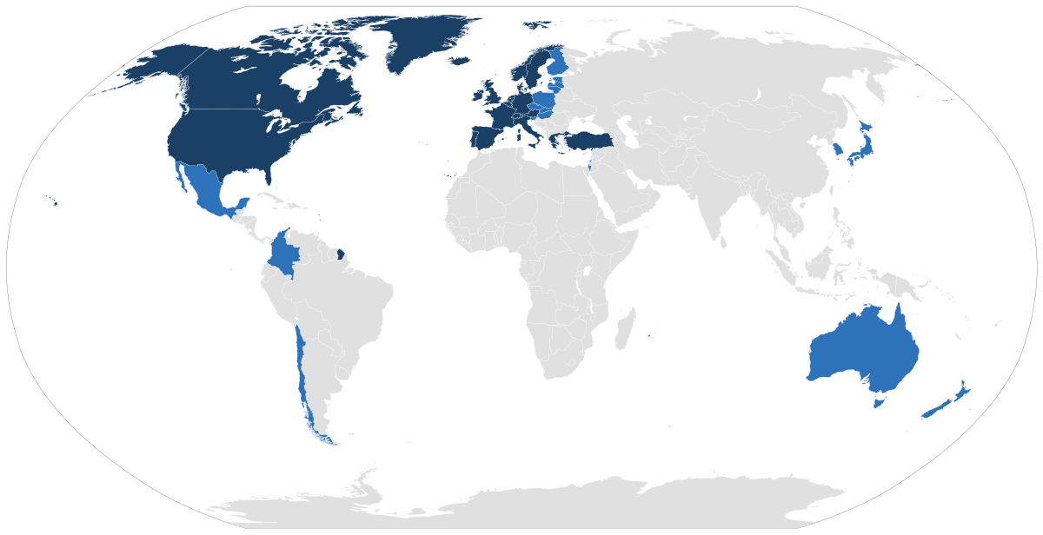
Regional Overview:
Organization for Economic Co-Operation and Development
Australia, Bulgaria, Canada, France, Germany, Japan, Sweden, Turkey, United Kingdom, United States
2.e
Housing context in OECD countries:
LACK OF SUPPLY:
Many OECD countries are trying to increase production of affordable housing options for both rent and purchase to stimulate the housing market.
INEQUALITY:
The countries of interest have high inequality rates, especially in the cases of the United States and Turkey. Many people are rent burdened, meaning rent constitutes the majority of their income.

Slide 29
Organization for Economic Co-Operation and Development: Housing Panorama
2.e
Housing Policy
Forced Eviction Policies
Sweden: A tenant can not be evicted before the rent tribunal or the district court has made a decision. In many municipalities there is a special section, a rental counseling, that will help persons who risk eviction due to unpaid rents.
France: The Government's Housing Strategy was launched September 2017. The strategy has three pillars: build more, better and cheaper housing to trigger a "supply shock", meet the needs of every individual and protect the most vulnerable, and improve living conditions
Sustainable Building Codes
UK: Launch of building safety program in 2017 to check for safety issues and sustainability ratings in older buildings.
USA: State-level sustainability programs are very popular.
Germany: Starting January 1, 2016 , Berlin is in effect passing a law governing how much it charges for apartments it controls, tenants in these buildings will pay no more than a third of their income in rent (and in some units with particularly steep energy costs, that will drop to a quarter of their income
Canada: New national housing strategy created to provide additional affordable housing and help people find affordable ways to purchase homes
Australia: National Rental Affordability Scheme launched in 2008 to provide affordable rentals at least 20% below market rates updated in 2020

Slide 30
Organization for Economic Co-Operation and Development: COVID-19 Measures
2.e
Governments in this region have been ensuring that people are housed through several measures, including:
1
Eviction Moratoria
USA: The United States Federal Housing Authority has ordered private mortgage lending enterprises to put a moratorium on evictions and foreclosures for at least 60 days starting March 28th.
Canada: Canadian provinces and territories have placed eviction bans and suspensions during the pandemic as a part of their economic response plan.
France: The “winter eviction truce” has been extended to July 10 due to the pandemic.
2
Freezing or deferral of mortgage/ rent prices/ housing payments
USA: Ban on late fees for any missed rent or mortgage payments in New York State.
3
Provision for Housing
Australia: Every territory in Australia has provided assistance to temporarily house people without homes in hotels and other such establishments.

Slide 31
Conclusions and Policy Recommendations
2.e
OECD Countries
Prioritize Temporary Housing Provisions
Australia’s response in housing rough sleepers has been quick, efficient, and successful. Other countries in the region have the capacity to replicate such a program through government funding and more focus on social protections instead of economic protections at this time. OECD countries can also take notice of other regions and their successful policies, such as the provision of temporary housing for those needing to isolate in Latin America.
1
2
Recognize lack of political will behind housing crisis in OECD countries
As seen through the COVID-19 crisis, OECD countries have the resources to mobilize housing for homeless and vulnerable citizens. OECD countries need to continue their commitment to housing and ensure that adequate housing is provided to all.
3
Integrate housing as a part of emergency response plans
It is clear that most OECD countries had difficulties at the beginning of the COVID-19 crisis, and continue to do so especially in terms of housing and quarantine facilities. Housing plans should be integrated into emergency response plans to ensure smooth future transitions during these times.
4
Rethink housing in times of crises
A major issue during the COVID-19 crisis has been a lack of effective shelter. Homeless shelters, along with other housing assistance institutions, should be labeled essential businesses so that they can continue to get funding and improve housing situations for those who need it.

Slide 32
3. GLOBAL CONCLUSIONS AND RECOMMENDATIONS

Slide 33
Conclusions and Policy Recommendations: Global
3.a
Housing Policy Recommendations:
Tax reform avoid predatory PPPs. Incentivize private sector w/ LIHTCs committed to revitalizing communities.
Housing policy needs to be included in disaster management on a national level that is adhered to by states.
'Just sustainability' (well being, quality of life, thinking about current and future generations) should be the focus as well as incorporating local materials, resources, and workforce to combat unemployment.
Ensuring justice and equity in terms of recognition, process, and outcome (participatory planning), particularly for women, youth, and other vulnerable populations.
Formalize community land trusts under the state.
Land-use and zoning practices that protects forests, wetlands, and other ecosystems while building new housing.
Rethink housing in times of crises to protect housing rights.
COVID-19 Policy Recommendations:
Stronger protection of vulnerable populations, i.e. migrants, indigenous populations, low income communities, women.
Provisions for temporary housing should be expanded.
Repurposing vacant units as long-term housing options.
Transitional shelters while long term provision are being made.

Slide 34
Best Practices
3.b
Housing Policies
National Housing Policy- Malaysia: Aimed to increase home ownership through sales and a rent-to-own scheme and setting the discounted prices for affordable housing.
Incentive to reduce environmental impact - Mexico City’s Sustainable Buildings Certification Programme (SBCP): It offers the owners or tenants of commercial, residential and industrial buildings an opportunity to reduce and demonstrate the environmental impact of their properties across a broad range of categories.
Cairo Housing Project - Egypt: In efforts to meet U.N SDGs, the gender strategies, and focus on the youth and poor, President Sisi’s project in Cairo encompasses global initiative goals.
Deliberate Inclusivity - South Africa: 30% of all developing mandated to be targeted at low-income households.
Eviction Policy - Angola: Working with tenants of affordable housing schemes to change terms of their loans and extending payment deadlines to avoid evictions.
COVID-19 Responses
Multi-layered Approach- India: States provided temporary shelter for the vulnerable, including homeless and migrant workers, and those needing to be isolated. At least one state, Delhi, prohibited eviction and provided other contingency measures for those affected.
Repurposing of vacant space into temporary shelter - Ecuador: The existing program to address homelessness was expanded and adapted for COVID-19 with a pavilion of Casa de la Cultura Ecuatoriana being repurposed to become a temporary shelter for the homeless, where they receive medical attention from the Health Secretary and the Red Cross.
Quick response in temporary housing provision - Australia: Australia has had quick responses in providing housing for homeless people during COVID-19. Every territory has provided housing in some capacity
Repurposing for temporary housing - Ethiopia: It has turned all university, school, and conference spaces into temporary housing and quarantine centers.
Visualization

Slide 35
THANK YOU

